Slide 1
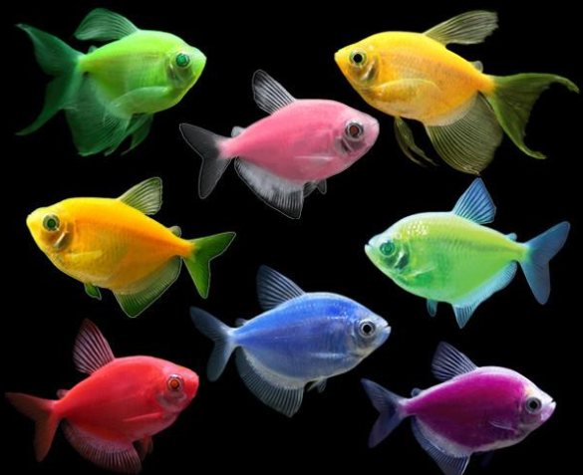
Techniques in Biotechnology
Recombinant DNA technology

Slide 2
Date: | Human Biology Year 12 ATAR
Do Now Past exam question Lesson Agenda 1: Do Now 2: Recombinant DNA Technology 3: Lesson summary and wind-up Suggested Study Complete review worksheet, then mark and correct using the answer key on Connect (compulsory) Read through today’s notes and textbook section NEXT LESSON Gene therapy and Tissue Engineering | Learning Aims Briefly explain the role of DNA in the manufacture of proteins. Explain how the following things are used in recombinant DNA technology: Restriction Enzymes Bacterial Plasmids DNA Ligase Describe the processes involved in producing a transgenic organism.
 | Key Vocabulary Gene Base sequence Restriction enzyme DNA Ligase Plasmid Vector Recombinant

Slide 3
Recombinant DNA Technology
Also called “genetic engineering”
Process of splicing DNA from one organism into another organism
Variety of uses.
Synthetic hormone production
Transgenic organisms – eg wheat that is resistant to herbicides
Gene therapy for diseases (still in the research phases)

Slide 4
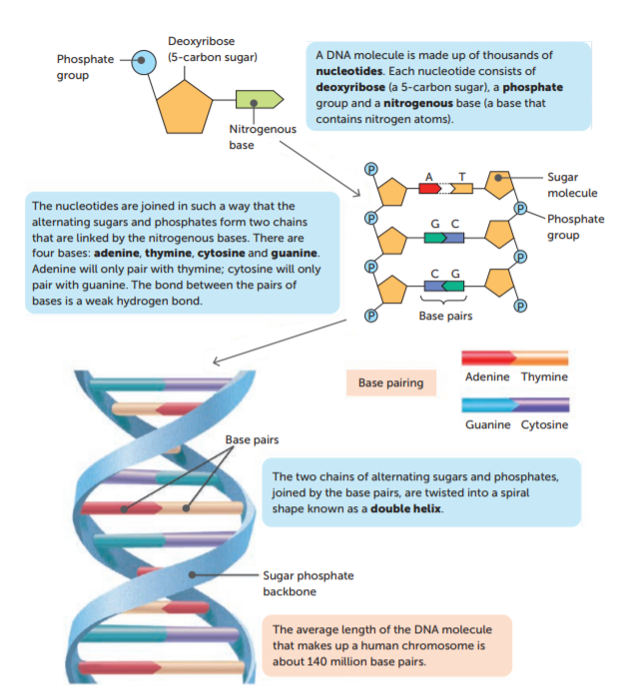
DNA Review
The sequence of bases that make up the DNA code for protein production by the cell.
A gene is a series of bases that code for the production of a particular protein.
For example, the insulin gene is the sequence of bases that codes for the production of the hormone insulin, and the growth hormone gene is the sequence of bases that codes for the production of growth hormone.
Learning Aim: Briefly explain the role of DNA in the manufacture of proteins.

Slide 5
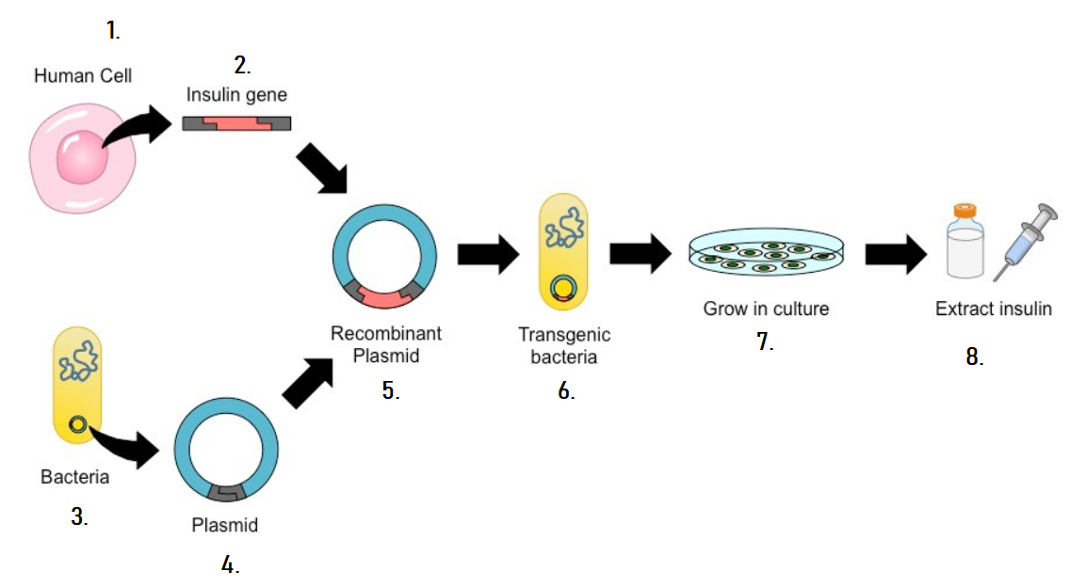
Putting a gene from one organism into another organism
Technology is available to put a gene from one organism into a totally different organism!
For example, scientists can put the insulin gene from a human cell into a bacterium, so that the bacterium produces the hormone insulin, which can then be extracted, refined and used to treat diabetes mellitus.
This involves:
Isolating (cutting out) the insulin gene from a healthy human cell, using a restriction enzyme.
Treating a piece of bacterial DNA with the same restriction enzyme.
Splicing the human insulin gene into the bacterial DNA.
Sticking the spliced pieces together with the enzyme DNA Ligase.
Putting the bacterial DNA back into the bacterium.

Slide 6
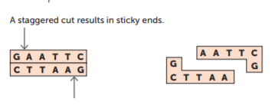
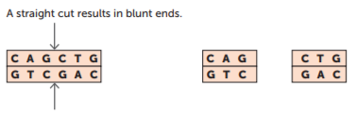
Isolating genes using Restriction Enzymes
Restriction enzymes are enzymes that cut DNA when they encounter specific base sequences.
There are different types of restriction enzymes, that target different base sequences.
Some make staggered cuts with sticky ends.
They target specific base sequences (recognition sites) that are palindromic – they read the same backwards and forwards.
The restriction enzyme cuts along the recognition site, producing a staggered cut with sticky ends. Other base sequences can bind if they have the same staggered cut and sticky ends.
These can be used to isolate segments of DNA containing genes
such as the insulin gene, or the growth hormone gene, and
allow them to be spliced into other DNA that has the same
staggered cut and sticky ends.
Some restriction enzymes make straight cuts with blunt ends. These are not as useful in recombinant DNA technology because they are less specific in what can join with them.
Fact: Restriction enzymes are used in nature, by bacteria, to restrict viruses called phages from infecting them.
Learning Aim: Explain how Restriction Enzymes are used in Recombinant DNA Technology

Slide 7
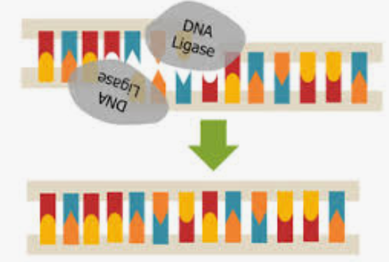
Splicing two pieces of DNA together using DNA Ligase
Two pieces of DNA that have been treated with the same restriction enzyme will have the same staggered cut and sticky ends - they will match even if they are from different types of organism.
For example, if the gene for insulin production is isolated from a human cell using a restriction enzyme, it will splice into DNA from a bacterium if the two are placed together.
Once two DNA sequences are put together with the same staggered cuts and sticky ends, they are treated with an enzyme called DNA Ligase which sticks them together.
Learning Aim: Explain how DNA Ligase is used in Recombinant DNA Technology

Slide 8

Animation of actions of restriction enzyme and DNA ligase

Slide 9
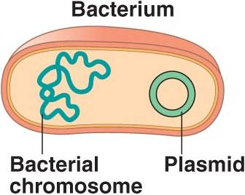
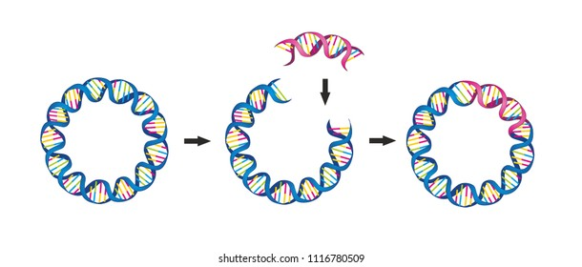
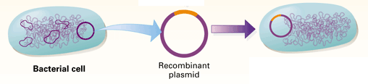
Splicing human genes into bacteria
Bacteria have long strands of DNA, but also have smaller, circular strands of DNA in their cytoplasm.
These small, circular strands of DNA are called plasmids.
Plasmids are removed from bacteria and treated with the same restriction enzymes used to isolate human genes, so the human gene can be spliced into the plasmid.
The plasmid (now containing a human gene, eg for insulin)
is a vector (carrier) that transports the human gene.
The plasmid is placed into a new bacterium, so that bacterium will carry the human gene. If it is carrying the human insulin gene, it will produce the hormone insulin!
Learning Aim: Explain how Bacterial Plasmids are used in Recombinant DNA Technology

Slide 10
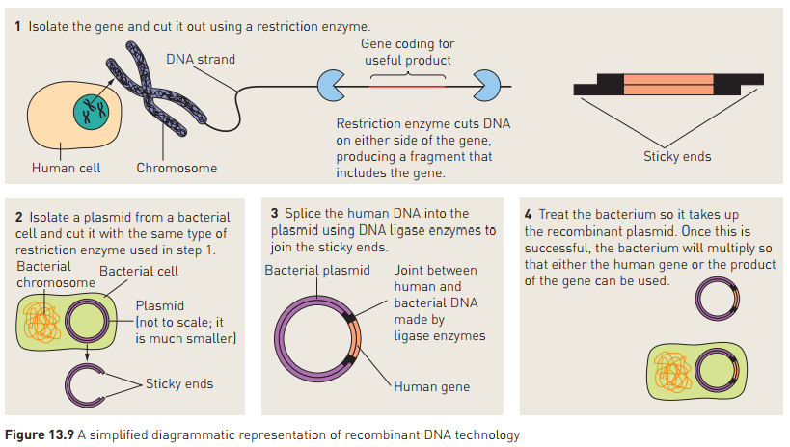

Slide 11
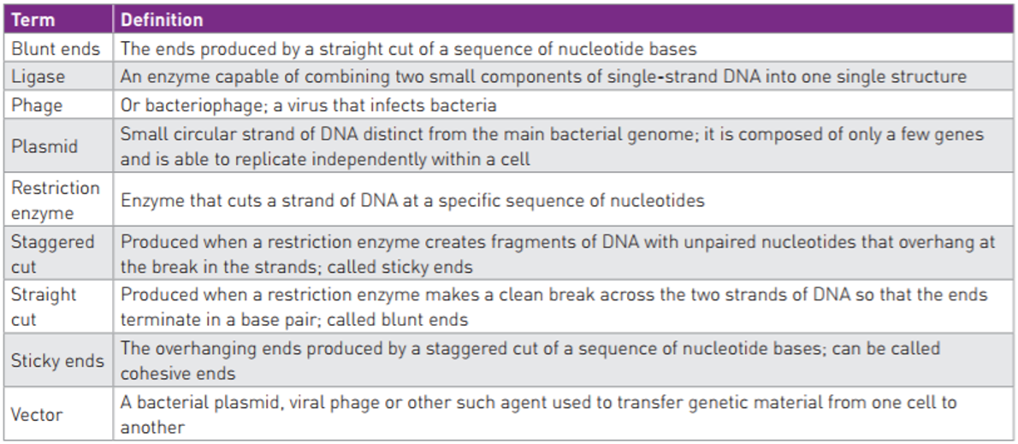
1: The base sequence coding for insulin production (the insulin
gene) is isolated from a healthy human cell.
2: The base sequence on either side of the gene is treated with a
restriction enzyme that cuts the base sequence, leaving a
staggered cut with sticky ends.
3: A plasmid is isolated from a bacterial cell.
4: The plasmid is treated with the same restriction enzyme that
was used on the insulin gene so that it has the same staggered
cut and the same sticky ends.
5: The human insulin gene is then inserted into the bacterial
plasmid, which fits because the plasmid and the gene have the
same staggered cut and sticky ends. The plasmid and insulin
gene are stuck together using the enzyme DNA Ligase.
6: The recombinant plasmid acts as a vector (carrier) of the human
insulin gene. It is inserted into a new bacterium, creating a
transgenic bacterium that contains the gene for human insulin.
Because it contains the gene for human insulin, the bacterium
can now produce human insulin hormone.
7: The transgenic bacterium is grown in culture, where it
reproduces until there is a large number of bacteria, all
producing the human insulin hormone.
8: The bacterial culture is processed to extract the hormone insulin
that the bacteria have produced and it is refined for human use,
to treat Type I diabetes.
Learning Aim: Describe in detail the sequence of events involved in producing synthetic insulin

Slide 12
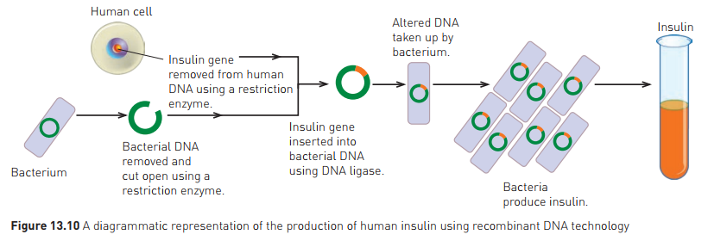
Examples of use
Insulin
Pre-1982, diabetics treated with insulin from pig/cattle pancreas
1982: insulin produced from genetically engineered bacteria approved – “Humulin”
Human gene spliced into bacterial cells, so bacteria would then produce insulin
Insulin now produced in huge vats of bacteria.

Slide 13
Examples of use continued
Human Growth Hormone
Now produced by genetically engineered E. coli bacteria
Used to treat lack of growth hormone in pituitary disorders
Also used in dairy cattle to increase milk production
Note: the process for making synthetic Human Growth Hormone using Recombinant DNA technology is exactly the same as for making synthetic insulin, except the gene for Growth Hormone is isolated and worked with, not the gene for insulin.
Learning Aim: Describe in detail the sequence of events involved in producing synthetic insulin

